Slide 1
Honours Macroeconomics
Business Cycle Theory Topic 1:
Introduction to Business Cycle Theory
and
The simplest Real Business Cycle model

Slide 2
Plan
Broad discussion of the definitions and measurement of business cycles
Develop a simple models with only real (as opposed to nominal) components
Two period model
Infinite General Equilibrium model

Slide 3
Business Cycle Theory
Many economic series show trending behaviour
You studied theories of economic growth with Monique
But the upward tendency is not smooth
The variations around these trends are studied under the heading of “business cycle theory” - this part of the course
The key policy issue is whether macroeconomic stability policy can provide welfare improving outcomes by smoothing the business cycle

Slide 4
Business Cycle Theory
First, some questions for class discussion:
What are business cycles? I.e. give a definition
How are business cycles measured?
What causes business cycles?
Should policy intervene in business cycles?
During upswings?
During downswings?
Always?

Slide 5
Caveat based on my personal view
All the theories in this course (and much of the discussion in the literature) make a fundamental assumption:
There are fundamental causes of the trending behaviour (growth)
I.e. a shock to the growth factors is permanent
And other causes of deviations from this trend
I.e. temporary shocks that eventually fade out, with or without policy intervention
Thus they can be studied/addressed separately
Growth policies vs Stabilization policies
An empirical problem:
Distinguishing between permanent and temporary shocks from the aggregate perspective is very difficult and entirely a function of the empirical approach
The wrong empirical approach will imply wrong identification of issues/problems and hence wrong policies
Salient issue: Is monetary policy neutral?
Most models assume the money supply is neutral in the long run, but modern monetary policy is conducted via controlling interest rates, not the money supply
A (growing) minority argues that the modern monetary policy approach may be non-neutral in the long run
E.g. excessively low policy interest rates contributed to the Global Financial Crisis of 2007/8, secular stagnation since then
I.e. policy rates that are too low may induce low growth rates

Slide 6
What are business cycles
Burns and Mitchel (1947) the first systematic attempt at a clear, replicable, precise definition and measure
“Business cycles are a type of fluctuation found in the aggregate economic activity of nations that organize their work mainly in business enterprises: a cycle consists of expansions occurring at about the same time in many economic activities, followed by similarly general recessions, contractions and revivals which merge into the expansion phase of the next cycle” (p.3)
Key components: up and down swings in many series – i.e. co-movement is key
They dated cycles by clustering of turning points in 100s of series

Slide 7
SARB
Uses a growth cycle approach
Rather than looking at turning points in the levels of aggregate variables, the SARB considers the cycle as deviation around the long run growth trend
Business cycle is defined by identifying turning points in the growth rate (around trend) of a set of indicators: lagging, coincident and leading
These indicators are constructed in a model-free sense:
rather than build a model, they use real indicators that suggest a speed-up/slow-down in economic activity
The components and weights of the indicators are continually adjusted to account for structural change in the economy
Source: Graph 2 in Venter, J.C., 2016. Business cycles in South Africa from 2009 to 2013. Quarterly bulletin, (279), pp.102-112.

Slide 8
SARB
Uses a similar approach:
Try to identify turning points in sets of lagging, coincident and leading indicators to identify the cycle turning points

Slide 9
SARB (from official release)
Uses a similar approach:
Try to identify turning points in sets of lagging, coincident and leading indicators to identify the cycle turning points

Slide 10
Measuring business cycles in models
In models like the ones we will build, the idea of a business cycle is somewhat differently conceived
The models are highly simplified (many fewer aggregate data series are considered)
The model tries to build a structural economic reason for the deviations that are called business cycles
The core idea is that there is some trend in potential output and that shocks cause a deviation around that trend
Think of the trend as the dynamic path of output in the steady-state of an RCK economy
A sequence of stochastic shocks (e.g. monetary policy shocks) means the economy is never at the steady state potential, but always tends towards it

Slide 11
Measuring business cycles in models
We will primarily focus on the theoretical side of things, but I wanted to make a brief comment on the empirical problems
To fit business cycle models of the type we will develop to trending data, we have to use some technique to “remove the trend”
This is different from either the co-movement approach of Burns and Mitchel (1947) or the growth cycle in composite indicators of the SARB
The underlying idea is that the trend is not directly modelled, so has to be “removed”
Probably a better approach is to use the model to do both – account for the trend and the cycle around it, but this is not standard practice
There are many techniques for modelling the trend exogenously:
Simple linear deterministic trend
A non-linear deterministic trend
A non-linear filter (e.g. moving average smoothing, Hodrick-Prescott filter or a Kalman filter)
Fitting models
Data reduction methods (Principal Component Analysis or Factor models)

Slide 12
From: Prescott (1986)

Slide 13
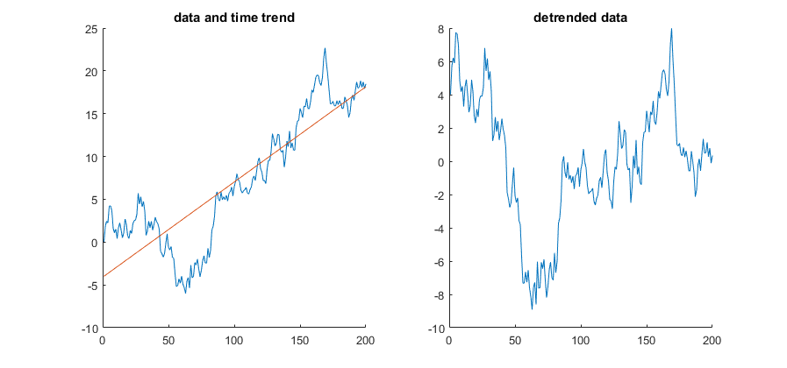

Different “cycles” due to different trends:
As illustration, I simulated a
unit root process,
$$y_{t}=y_{t−1}+ε_{t}$$
which by
construction does not have
a deterministic trend.
Then I applied simple
De-trending techniques to
Show that the (imposed)
trend determines the
(estimated) cycle.

Slide 14
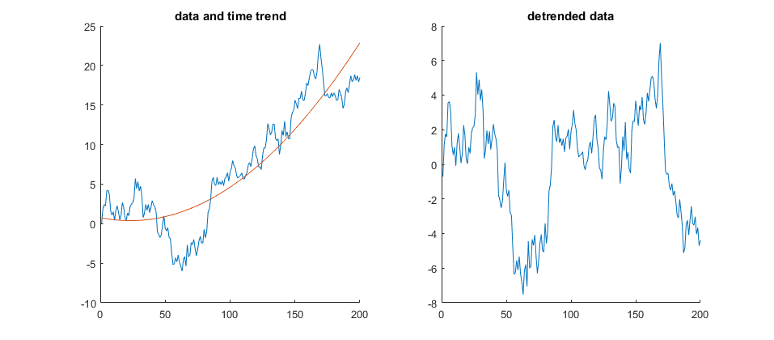
Different “cycles” due to different trends:

Slide 15
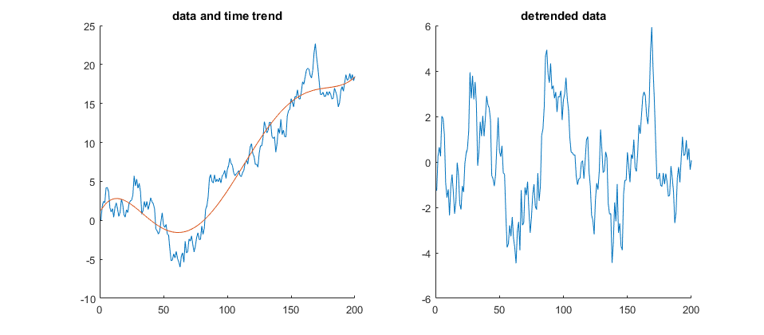
Different “cycles” due to different trends:

Slide 16
Measuring business cycles in the data
There are many techniques
The big risk:
Your choice of trend determines the cycle you get
If you use an inappropriate method, you will be explaining a spurious business cycle
Especially problematic is if you remove the trends independently from different series
Business cycles are neither regular, nor sinusoidal
The only safe method is a fundamentally economically motivated approach
Must at least match something like a data intensive approach of the SARB/Fed
Multivariate Kalman Filters are a statistically motivated approach that is probably the most defensible

Slide 17
Business Cycle Theory
First, some questions:
What are business cycles? I.e. give a definition
How are business cycles measured?
What causes business cycles?
Should policy intervene in business cycles?
During upswings?
During downswings?
Always?

Slide 18
Modern business cycle models Kehoe et al (2018)
A response to the Lucas Critique (1976)
An econometric model that is not able to uncover deep, policy invariant parameters that describe the structure of the economy is useless as a guide to decide on policy intervention
E.g. in the static Keynesian model: The “Marginal Propensity to Consume” is sensitive to the interest rate, beliefs of consumers, not an exogenous parameter to be estimated
The problem: if you estimate the statistical regularity of a policy dependent feature, it will not be valid if you plug in a different policy regime
Patterns of aggregate variation must be derived from primitives that are defensibly independent of policy
Technology
Preferences
Information
Rules of interaction
Equilibrium definition
Agents think inter-temporally in all decisions

Slide 19
Modern business cycle models Kehoe et al (2018)
Real Business Cycle models
Early models abstracted from money, as we will do today
Optimal inter-temporal Consumption, Investment and Labour supply
Only technology shock
Why technology shocks? And what is a technology shock?
In the model it will be very simple: a stochastic disturbance to the “A” factor – total factor productivity
A short-cut stand in for a more complex idea
It is not assumed that firms “forget” their production technology (as we thought of this idea in microeconomics)
Rather, it serves as a “a stand-in for deeper models of how economic outputs and inputs adjust to various nonproductivity shocks.”
Why real?
Not because there is any belief that money cannot have real effects (think hyperinflation)
The Lucas critique forced a rethink of how to model business cycle events
A good model is only as complicated as it needs to be to tell its story
The early RBC authors thus started with the simple model we do today
It did remarkably well
Prescott (1986) and Kehoe et al (2018) argues that these very simple models, with only real frictions, can come close to a “plausible” explanation for many aggregate observations from the data, and produces the same type variations
Of course, this is based on the econometric techniques/beliefs at the time, particularly the definition of a business cycle.
Many disagreements, but try to avoid thinking in terms of ideological schools of thought – be agnostic and critical

Slide 20
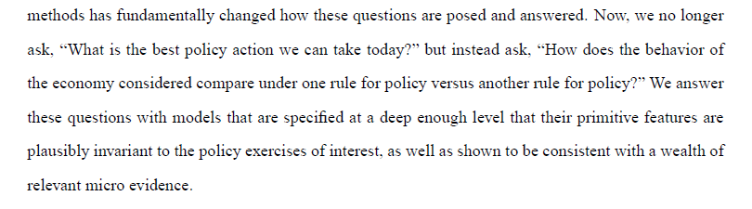
Modern business cycle models Kehoe et al (2018)
The early success of the RBC model, and its strong foundations means it is still the core of current models
It is based on RCK growth model, but now with technology shocks
We will study it as the real part of the final New Keynesian model (which allows for money and nominal frictions) that is central to policy analysis
What is the purpose of this modelling exercise? A quote from Kehoe et al (2018) :

Slide 21
Generations of models: Kehoe et al (2018)
First Generation:
Pure RBC models, built to match moments (means, variances, covariances) of the data
Use only technology shocks and real frictions
Key attempt: explain variation
Second Generation:
New Keynesian models, built to capture dynamics of aggregate series
Many more equations, shocks, frictions, including nominal features (the New Keynesians would argue!)
Motivated by behaviour of model, not micro evidence
Third Generation:
Use detailed, disaggregated micro data to motivate new mechanisms
Very computationally intensive, hence becoming popular now.

Slide 22
Business Cycle Theory
First, some questions:
What are business cycles? I.e. give a definition
How are business cycles measured?
What causes business cycles?
Should policy intervene in business cycles?
During upswings?
During downswings?
Always?

Slide 23
Stabilisation policy
Can aggregate policy measures (e.g. monetary and fiscal policy) improve welfare by “smoothing out the business cycle”?
In the models:
If there are no frictions (e.g. sluggish price adjustment, credit constraints etc), no – all responses are optimal – the model is in Pareto efficient equilibrium at all times
If there are frictions, yes – if prices are slow to adjust, demand may be sub-optimally low after a negative shock and expansionary policy can improve welfare (present value of lifetime utility)
Caveat: these models were built to analyse “optimal policy”, thus unsurprising that they find a positive role for policy. Whether this translates to the real world depends on how accurate the models are
Unfortunately, we will not be able to go deep enough into the models to get to the formal version of this answer
In practice:
If and only if the policy maker is less constrained than the market economy and has more information can this occur
The problem with stabilisation policy is if it has long run consequences:
Low interest rates to battle a recession leading to excessive risk taking/debt accumulation
Covid income grants in South Africa?

Slide 24
To the models!
Think of this part as tool building, rather than exposing real-world economic truths
The models will not be realistic, but the methods used extend naturally to more realistic settings
The more realistic, the more complicated, the more difficult to follow the intuition
The basic ideas extend through even the most complicated models
Take cognisance of all the short-comings, but focus strongly on understand how we achieve the very limited goals we set
Understand the purposes (and costs) of the assumptions, and understand how to get to and interpret the results

Slide 25
Impact of interest rates: beyond the Euler Equation
The key component of all macro models is the inter-temporal dimension
In previous models you have found that an important impact of the interest rate is its effect on the incentives for saving:
It also has an impact on labour supply, however, in a full dynamic model.
Since savings depend on the interest rate, it also determines when it is sensible to work more, which has productive consequences, and can act as a transmission mechanism for technology shocks.
To isolate this effect analytically, we study labour supply effects of the interest rate in a simple two period model.

Slide 26
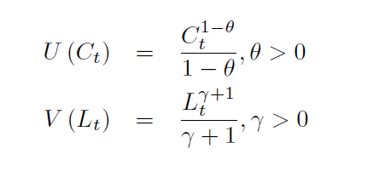
2 period model
Households make two decisions: how much to work and how much to consume, maximize a standard utility function:

Slide 27
2 period model
The budget constraint is:

Slide 28
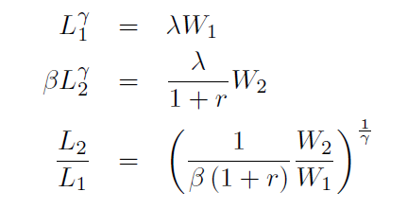
2 period model
The Lagrangian and first order conditions:

Slide 29
2 period model
Intertemporal labour supply:
What is the impact of a change in interest rate on labour supply?
The intertemporal nature of the hours worked is a key variable that a good model must match.
Not all recessions are the same (Kehoe et al 2018):
1982: output and measured productivity drop similar, hours drop less (common)
2008: measured productivity constant, hours fall more than output (new)

Slide 30
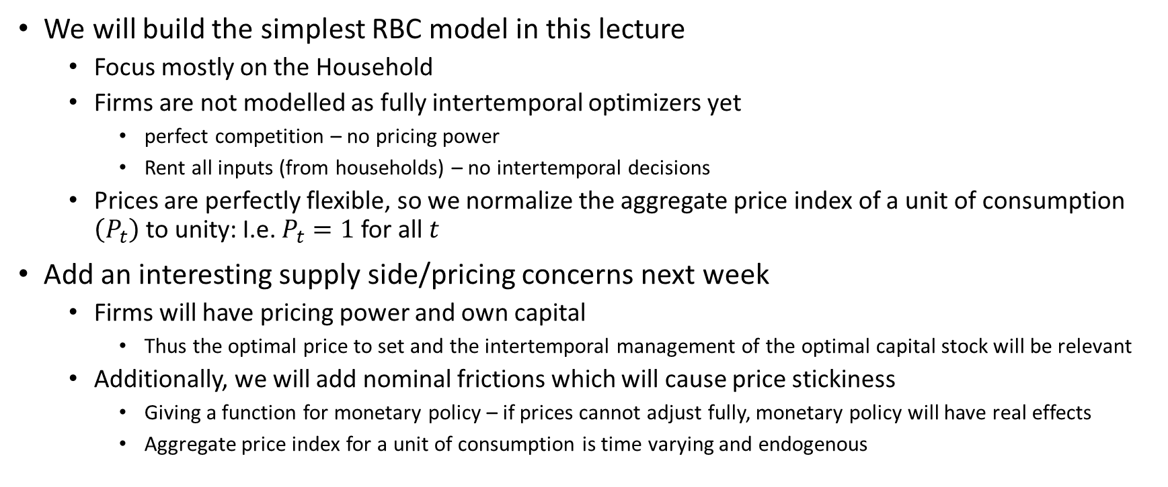
First steps towards the New Keynesian model
We will build the simplest RBC model in this lecture
Focus mostly on the Household
Firms are not modelled as fully intertemporal optimizers yet
perfect competition – no pricing power
Rent all inputs (from households) – no intertemporal decisions
Prices are perfectly flexible, so we normalize the aggregate price index of a unit of consumption $\left(P_{t}\right)$to unity: I.e. $P_{t}=1$ for all $t$
Add an interesting supply side/pricing concerns next week
Firms will have pricing power and own capital
Thus the optimal price to set and the intertemporal management of the optimal capital stock will be relevant
Additionally, we will add nominal frictions which will cause price stickiness
Giving a function for monetary policy – if prices cannot adjust fully, monetary policy will have real effects
Aggregate price index for a unit of consumption is time varying and endogenous

Slide 31
Complete model (Prescott 1986, simplified):
We consider a real economy with the following features:
Infinitely lived consumer
Derives utility from consumption and leisure
i.e. supplies Labour at disutility
Owns and invests in capital that depreciates at a constant rate – in this simple model, it is only asset that exists to save in
Dynamic problem – very different from micro
Perfectly competitive firms that employs a stochastic constant returns to scale production function
Technology grows, but with slow fading shocks
Hires labour at a competitive wage
Hires capital at a competitive rate of return
All inputs flexible, free entry
Period-by-period problem = static, as in micro
We abstract from government from the start for simplicity

Slide 32
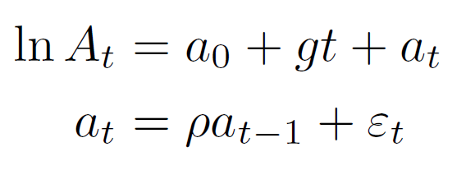
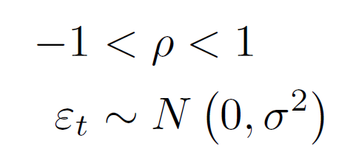
Firm problem
Production technology:
Firms minimize costs of production
paying wage W and capital r per unit
And firms are always in the competitive long run
Important new part: Technology (or rather: total factor productivity) grows at a stochastic rate
where:

Slide 33
Firm problem
Lagrangian of the cost minimization problem:
Note a difference from Romer:
He skips the firm step, so the definition of r differs
We will add it later
Our model: firm just rents the capital, so doesn’t see the depreciation

Slide 34
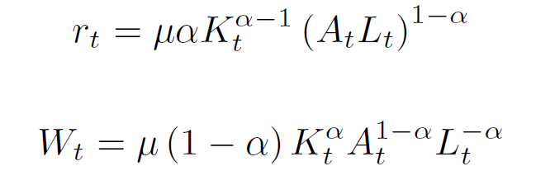
Firm problem
Lagrangian of the cost minimization problem:
First order conditions:

Slide 35
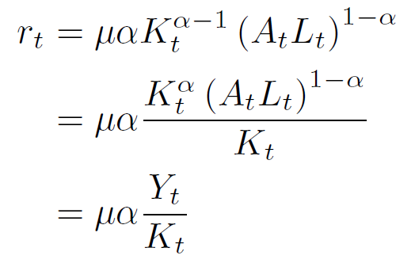
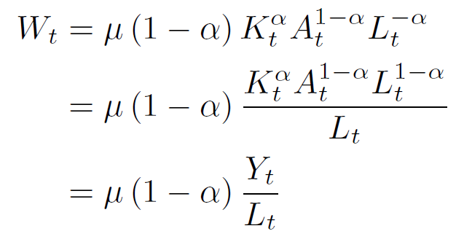
Firm problem
Rewrite the first order conditions:

Slide 36

Firm problem
Now impose perfect competition
Perfect competition implies zero profits – i.e. all resources are paid out to purchase inputs
Thus:

Slide 37
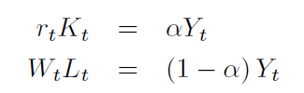
Firm results:
Two interpretations:
Each factor gets its fair share of the output:
The capital labour ratio depends on the relative productivity and relative costs:

Slide 38
Firm results:
What’s different from micro?
Return on capital and wage are endogenous processes
we have to solve for them in general equilibrium
They are both stochastic processes
Not fully predictable

Slide 39
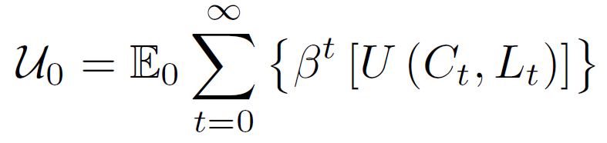
Consumer Problem:
Utility function:
Features:
The objective function is the “beginning of time” expected present value of lifetime utility – the economy is stochastic/uncertain
Likes consumption, dislikes labour, discounts the futre
What is a solution for this problem, given the uncertainty?

Slide 40
Consumer Problem:
Utility function:
Features:
The objective function is the “beginning of time” expected present value of lifetime utility – the economy is stochastic/uncertain
The consumer likes consumption, dislikes labour, discounts the future
What is a solution for this problem, given the uncertainty?
A consumer cannot choose all values (or time paths) for consumption/labour ex ante
Must choose optimal conditional plans also called policy functions
In each period, given the outcome of the random TFP and stock of capital, what is the best choice of consumption and labour?

Slide 41
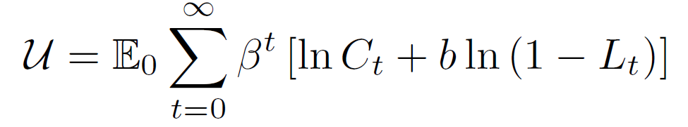
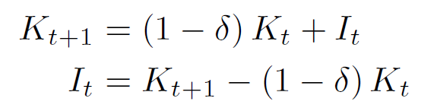
Consumer Problem:
For simplicity, we use a specific functional form:
Budget Constraint:
Income
Expenditure: Consume (C) or Invest (I):
Capital depreciates, so:

Slide 42
Consumer Problem:
Utility function:
Budget Constraint:

Slide 43
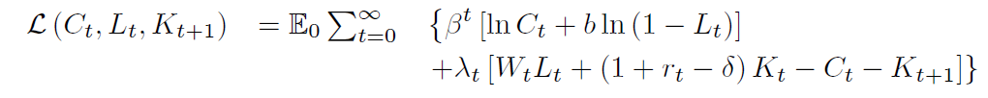
Consumer Problem:
Lagrangian:

Slide 44
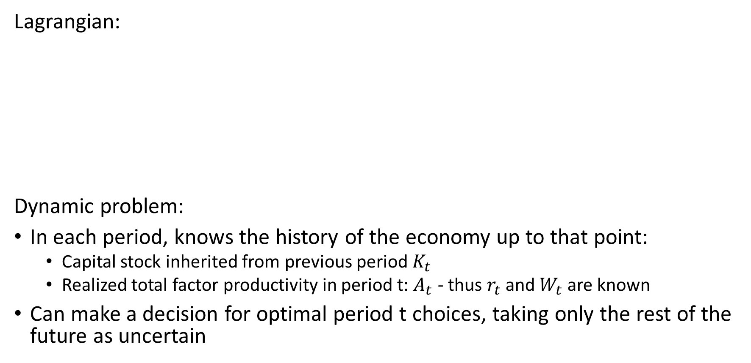
Consumer Problem:
Lagrangian:
Dynamic problem:
In each period, knows the history of the economy up to that point:
Capital stock inherited from previous period $K_{t}$
Realized total factor productivity in period t: $A_{t}$ - thus $r_{t}$ and $W_{t}$ are known
Can make a decision for optimal period t choices, taking only the rest of the future as uncertain
Choice variables

Slide 45
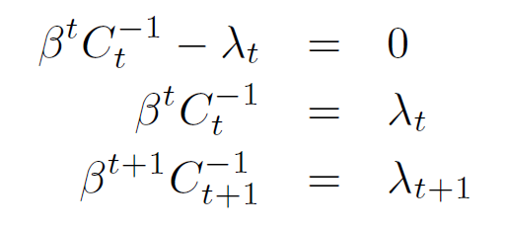
Consumer Problem:
Lagrangian:
Consumption FOC:

Slide 46
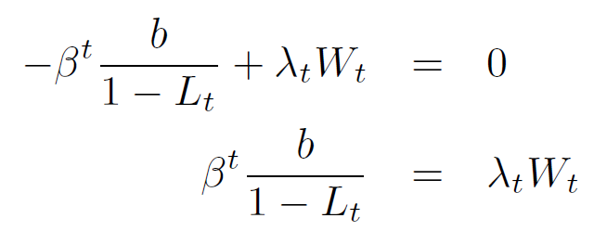
Consumer Problem:
Lagrangian:
Labour FOC:

Slide 47
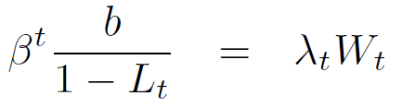
Consumer Problem:
Lagrangian:
Optimal Labour supply:
Take ratio:
Marginal Rate of Substitution of Consumption for Labour
Market cost of consumption relative to earnings per unit labour

Slide 48
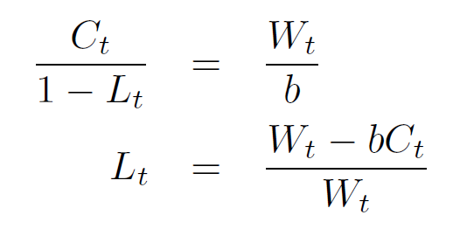
Consumer Problem:
Lagrangian:
Labour supply function:

Slide 49
Consumer Problem:
Lagrangian:
Capital FOC:

Slide 50
Consumer Problem:
Note: this “unpacking” is to assist those that struggle to intuitively work with summation. This is not how you should present the answers in an assessment/paper
Lagrangian Unpacked:
Capital FOC:

Slide 51
Consumer Problem:
Lagrangian Unpacked:
consumer can choose K_t+1 in period t, but does not know the future:
, are uncertain

Slide 52
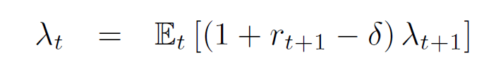
Consumer Problem:
Lagrangian:
Capital FOC:

Slide 53
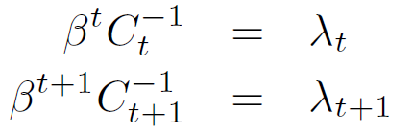

Consumer Problem:
Lagrangian:
Euler equation:

Slide 54
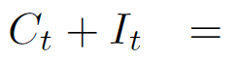
Equilibrium:
A general equilibrium in this economy is defined as time paths for all endogenous variables (Consumption, Labour, Investment, Wages, Interest rates and Lagrange multipliers) such that:
All agents behave optimally: Consumers: Firms:
Markets clear in every period:
Note: we have six unknowns in six equations

Slide 55
How to solve this model?
The equilibrium conditions are not yet a solution of the model
We have six unknowns connected by six equations
Defining a Solution: The solution of a dynamic general equilibrium model is
a set of closed form, time invariant equations expressing each variable in terms
Initial conditions
exogenous shocks
parameters
This is difficult in our model
since it is
Non-linear
Stochastic
Forward Looking
And the solutions are not numbers but functions

Slide 56
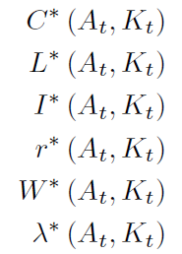
How to solve this model?
The equilibrium conditions are not yet a solution of the model
We have six unknowns connected by six equations
Defining a Solution: The solution of a dynamic general equilibrium model is
a set of closed form, time invariant equations expressing each variable in terms
Initial conditions
exogenous shocks
parameters
This is difficult in our model
since it is
Non-linear
Stochastic
Forward Looking
And the solutions are not numbers but functions
A solution is a set of explicit functions of things known at time t

Slide 57
How to solve this model?
The equilibrium conditions are not yet a solution of the model
We have six unknown functions connected by six non linear equations
Defining a Solution: The solution of a dynamic general equilibrium model is
a set of closed form, time invariant equations expressing each variable in terms
Initial conditions
exogenous shocks
parameters
Our model is highly non-linear so this is not feasible
Moreover, we want solutions to be general, not a function of specific forms
Approach:
Model simplifications (see Romer)
Standard: Linear approximation around steady state
You will learn these techniques in detail if you stay for a Masters

Slide 58
How to solve this model?
A closed form solution exists only for a very special simplified version of the model:
Log utility (which we started with)
100% depreciation
Romer shows you how to do this (not intuitive, purely algebraic)
In all other cases the model can only be solved in approximation around a steady state
This is not difficult, but it is
Tedious
Complicated (many simple steps, tons of algebra)
I will give you just a flavour of it in a future lecture/tutorial

Slide 59
How do we interpret the results from this model?
State Variable
Suppose we have a solution to the model:
I.e. policy functions that describe the optimal choice for any
Current capital stock (“state variable”)
Which depends on all past shocks
And past optimal choices
Current realization of the technology shock (“shock realization”)
Then we can simulate the dynamic path of this economy multiple times
Check whether the “typical” prediction of the model matches the data
Shock Realization

Slide 60
How do we interpret the results from this model?
To simulate the model we need to impose model parameters
E.g. the utility parameters, technology parameters, stochastic process
This can be done in a number of ways:
Calibrate the model, i.e. choose the model parameters
Based on micro evidence
Matching certain relatively constant ratios in the macro data (e.g. Capital as a proportion of Output)
Estimating the model directly with data
You will do this with Guangling if you do your masters

Slide 61
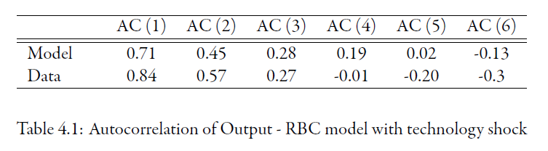
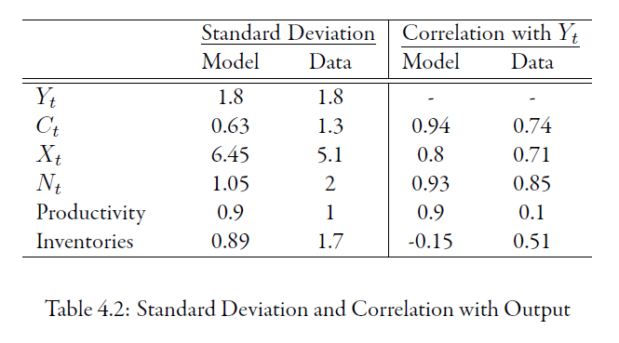
How do we interpret the results from this model?
Source: https://www.economodel.com/macroeconomics

Slide 62
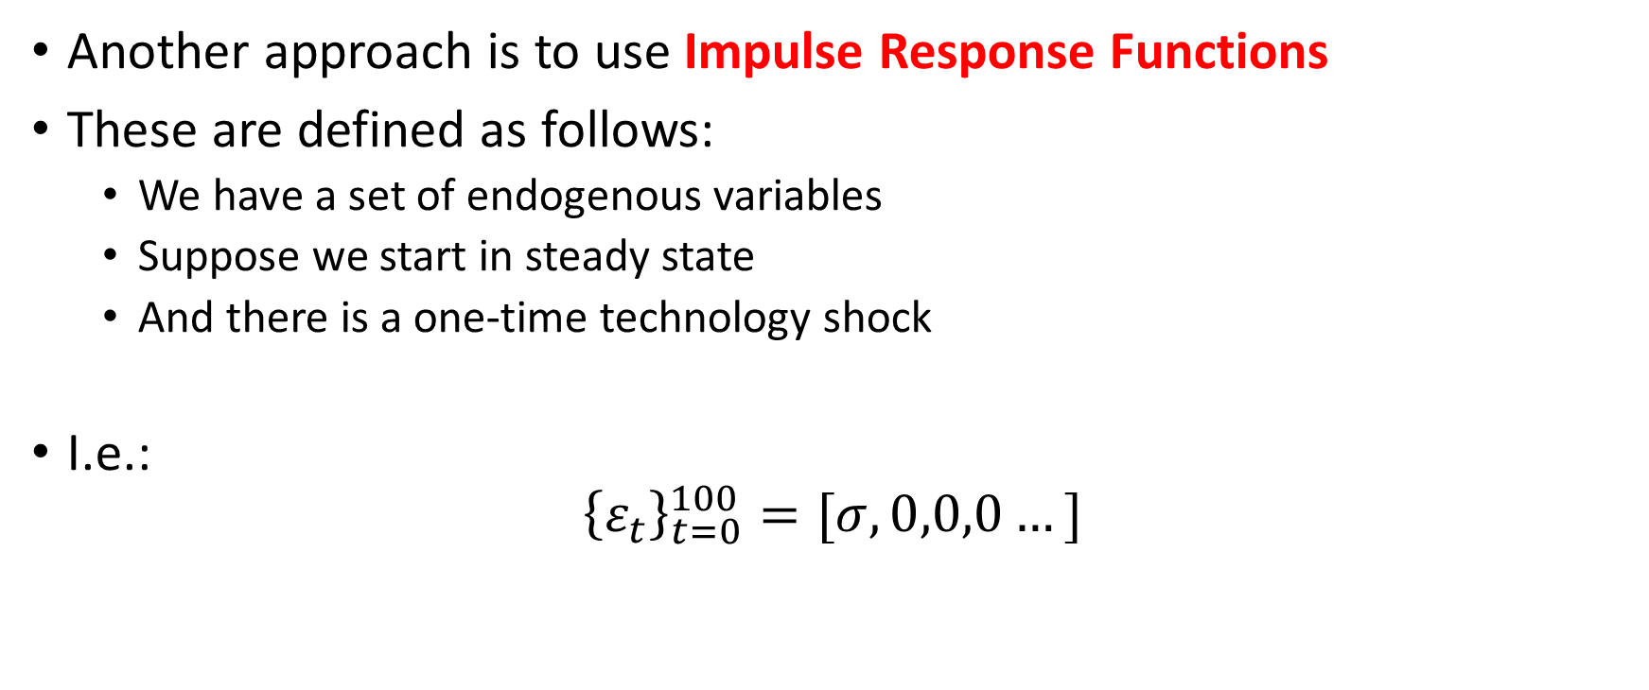
How do we interpret the results from this model?
Another approach is to use Impulse Response Functions
These are defined as follows:
We have a set of endogenous variables
Suppose we start in steady state
And there is a one-time technology shock
I.e.:
$${\left\{ε_{t}\right\}}_{t=0}^{100}=[σ,0,0,0…]$$

Slide 63
How do we interpret the results from this model?
Another approach is to use Impulse Response Functions
These are defines as follows:
We have a set of endogenous variables
Suppose we start in steady state
And there is a one-time technology shock
What does the dynamic paths of the model variables look like as they return to steady state?
I.e. we study the log-deviation of each variable from its steady state
Using simulations based on the calibrated/estimated parameters

Slide 64
Source: https://www.economodel.com/macroeconomics

Slide 65
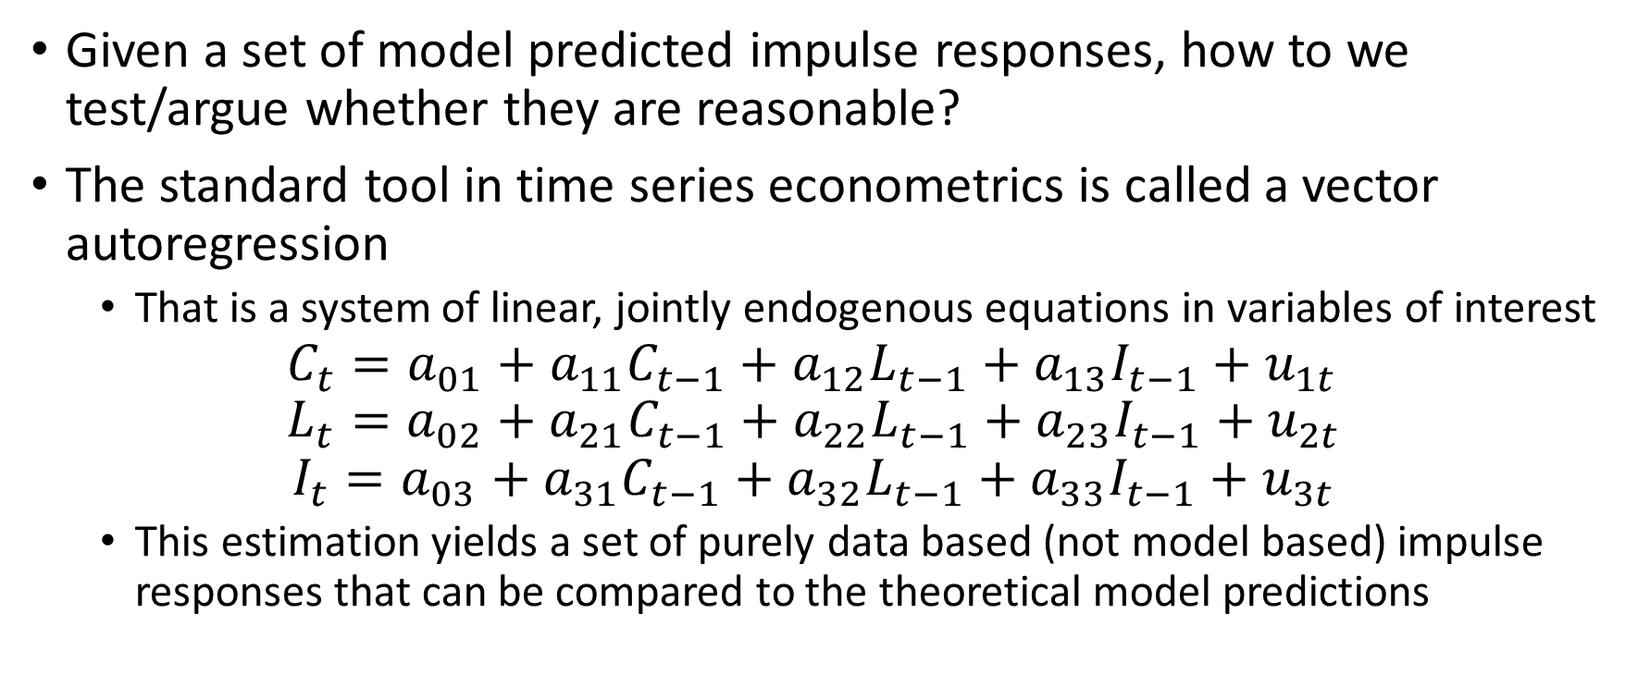
Impulse responses
Given a set of model predicted impulse responses, how to we test/argue whether they are reasonable?
The standard tool in time series econometrics is called a vector autoregression
That is a system of linear, jointly endogenous equations in variables of interest
$$C_{t}=a_{01}+a_{11}C_{t−1}+a_{12}L_{t−1}+a_{13}I_{t−1}+u_{1t} \\ L_{t}=a_{02}+a_{21}C_{t−1}+a_{22}L_{t−1}+a_{23}I_{t−1}+u_{2t}$$
$$I_{t}=a_{03}+a_{31}C_{t−1}+a_{32}L_{t−1}+a_{33}I_{t−1}+u_{3t}$$
This estimation yields a set of purely data based (not model based) impulse responses that can be compared to the theoretical model predictions

Slide 66
Example of evaluating a model:
This is from one of the most important contributions in this literature
The authors do the following:
Grey areas – 95% confidence interval of IRF from a VAR (point estimate not shown)
Black line – an IRF of a benchmark model
Dashed line – an IRF of their proposed model
from Christiano, Eichenbaum and Evans (2005, JPE)

Slide 67
In the next two weeks we will add monopolistic firms with pricing power, as well as persistence in prices

